Slide 1
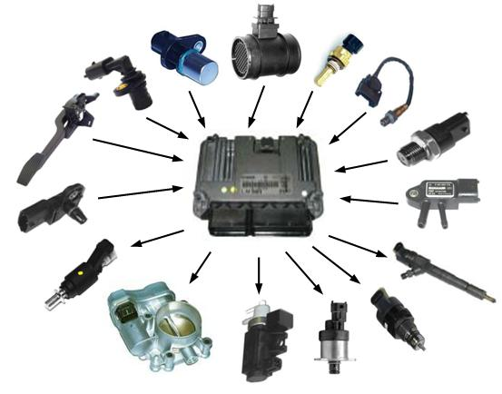
Sensors and Actuators

Slide 2
Contents
Transducer
Sensors
Characteristics of Sensors
Classification of Sensors
Actuators
Classification of Actuators

Slide 3
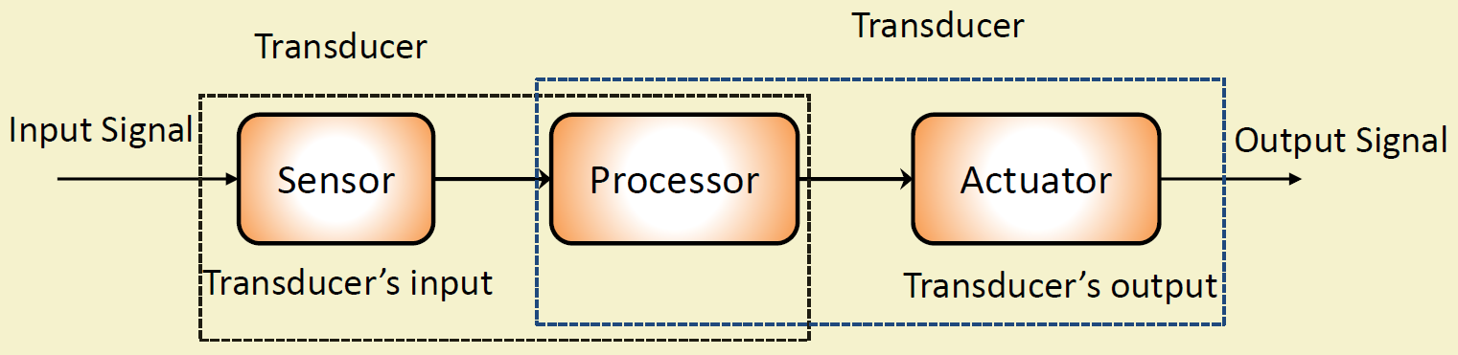
Transducer
A transducer is a device that converts energy from one form to another.
Used in boundaries of automation, measurement, and control systems, where electrical signals are converted to and from other physical quantities (energy, force, torque, light, motion, position, etc.).
The process of converting one form of energy to another is known as transduction.

Slide 4
Transducer:
Converts a signal from one physical form to another physical form
Physical form: thermal, electric, mechanical, magnetic, chemical, and optical
Energy converter
Examples:
Microphone : Converts sound to electrical signal
Speaker : Converts electrical signal to sound
Antenna : Converts electromagnetic energy into electricity and vice versa
Strain gauge : Converts strain to electrical

Slide 5
Sensors
A sensor is a device that measure, detects and responds to some type of input from the physical environment.
That input could be heat, light, motion, pressure, moisture or any one of a great number of other environmental phenomena.
The output is generally a signal that is converted to human-readable display at the sensor location or transmitted electronically over a network for reading or further processing.
Performs some function of input by sensing or feeling physical changes in the characteristic of a system in response to stimuli.

Slide 6
Characteristics of Sensors
Static characteristics
After steady state condition, how the output of a sensor change in response to an input change
Dynamic characteristics
The properties of the system’s transient response to an input
How well a sensor responds to changes in its input

Slide 7
Static Characteristics
Accuracy
Represents the correctness of the output compared to a superior system
Range
Gives the highest and the lowest value of the physical quantity within which the sensor can actually sense
Errors
Resolution
Provides the smallest change in the input that a sensor is capable of sensing
Higher the resolution better the precision
Sensitivity
The difference between the standard value and the value produced bysensor
Linearity
Sensitivity indicates ratio of incremental change in the response of the system with respect to incremental change in input parameter
Drift
Repeatability
The deviation of sensor value curve from a particular straight line
The different between the standard and the measured value
Beyond this value there is no sensing or no kind of response
The difference in the measurements of sensor from a specific reading when kept at that value for a long period of time
The deviation between measurements in a sequence under same conditions

Slide 8
Dynamic Characteristics
Zero order system
Output shows a response to the input signal with no delay
First order system
When the output approaches its final value gradually
Second order system
Complex output response
The output response of sensor oscillates before steady state
Consists of an energy storage and dissipation element
Does not include energy storing elements
Example: Potentiometer measures linear and rotary displacements

Slide 9
Classification of Sensors
Sensors
Passive & Active
Analog & Digital
Scalar & Vector

Slide 10
Classification of Sensors
Passive
Cannot independently sense the input
Example:
Accelerometer,
Soil Moisture,
Water level and
Temperature Sensors
Active
Independently sense the input
Example:
Radar,
Sounder and
Laser Altimeter Sensors
Analog Sensor
The response or output of the sensor is some continuous function of its input parameter
Example:
Temperature sensor ,
LDR,
Analog Pressure Sensor and
Analog Hall Effect/Magnetic Sensor
Digital Sensor
Responses in binary nature Designs to overcome the disadvantages of analog sensors
Along with the analog sensor it also comprises of extra electronics for bit conversion
Example:
Passive Infrared (PIR) Sensor
and Digital Temperature Sensor (DS1620)
Scalar Sensor
Detects the input parameter only based on its magnitude
Response of the sensor is a function of magnitude of the input parameter
Not affected by direction of input parameter
Example:
Temperature, Gas, Strain, Color and Smoke Sensors
Vector Sensor
Response of sensor depends on magnitude of direction and orientation of input parameter
Example
Accelerometer,
Gyroscope,
Magnetic Field Motion Detector Sensors

Slide 11
Examples of Sensors
Temperature Sensor
A Temperature Sensor is a device which is used to measure heat or temperature on the operating machine part. Temperature sensing is performed by gadget called Thermocouple. A thermocouple is a temperature-measuring device consisting of two dissimilar conductors that contact each other at one or more points. It produces a voltage when the temperature of one of the points differs from the reference temperature at other parts of the circuit.
Proximity Sensor
proximity sensor is using to detect the motion and very common to use in retail shop, through this device retailer will use customer’s proximity to any product and same time they can sent the coupons and deals to the customer’s mobile or on email. Now a days proximity sensor are using to check the availability or free spaces like parking space, sitting spaces in sports stadium, mall and airports.
Pressure Sensor
A pressure sensor is a gadget equipped with a pressure-sensitive element that’s used to measure the pressure of a liquid or a gas against a diaphragm made of silicon, stainless steel, etc., and converts the measured value into an electrical signal as an output. It’s also use to measure the water flow through pipes or tank and notify the concern person when something need to be fixed. Now a days pressure sensor is used in aircraft and vehicles to determine the altitude and force, continuously.
Water Quality Sensor
Water quality sensor are mainly used to measure a dozen of the most relevant water quality parameters, Wasp-mote Smart Water is the first water quality-sensing platform to feature autonomous nodes that connect to the Cloud for real-time water control. It’s used to measure quality of sea water, river water and etc.

Slide 12
Examples of Sensors
Chemical/Smoke and Gas Sensor
smoke and gas detector is a gadget that sense gas, smoke and typically it’s an indicator of fire. Now a days all security devices using this sensor to passing signal to fire alarm to control panel. Household smoke detector is also known as smoke alarm, most of the device manufacturer using audible or visual alarm system in security devices that detect automatically.
Level Sensor
It’s used to detect the level of liquids and other fluids and fluidized solids, including granular materials, slurries and powders that exhibit an upper free surface. Level sensors is also using for water waste management and recycling purpose, like it’s using to measure water tank levels, petrol fuel gauging, high or low level alarm, liquid assets inventory and irrigation control.
IR Sensor
This smart gadget is used to detect the infrared lights. Infrared sensor visualize the heat leaks in houses, identify environmental chemicals in the environment, and helping doctor to measure patient blood flow. It can be integrated with wearable electronics. A very simple example, all the remotes having IR sensor, it’s using to pass the command to respective devices, like TV remote, fan remote, vehicle key remote all having infrared sensor.
Ultrasonic Sensor
An Ultrasonic sensor is used to measure the distance between the two object by using sound waves. It’s measure distance by sending sound wave at a specific frequency and listen that sound wave house to measure distance. There are two kind of an ultrasonic sensor is, “active ultrasonic sensor” and “passive ultrasonic sensors”. An active ultrasonic sensors generates the high frequency sound wave to receive back the ultrasonic sensor for evaluating the echo. But, passive ultrasonic sensors are just used for detecting ultrasonic noise which is present under specific conditions.

Slide 13
Actuator
Part of system that deals with the control action required (mechanical action)
Mechanical or electro-mechanical devices
A control signal is input to an actuator and an energy source is necessary for its operation.
Available in both micro and macro scales.
Energy Source
Actuator
Control Signal
Motion/Force

Slide 14
Types of Actuators
Hydraulic
Pneumatic
Electrical
Thermal/ Magnetic
Mechanical

Slide 15
Hydraulic Actuators
A hydraulic actuator consists of a cylinder or fluid motor that uses hydraulic power to facilitate mechanical operation.
The mechanical motion is converted to linear, rotary or oscillatory motion.
Since liquids are nearly impossible to compress, a hydraulic actuator exerts considerable force.
The actuator’s limited acceleration restricts its usage.

Slide 16
Pneumatic Actuators
A pneumatic actuator converts energy formed by vacuum or compressed air at high pressure into either linear or rotary motion.
Pneumatic rack and pinion actuators are used for valve controls of water pipes.
Pneumatic energy quickly responds to starting and stopping signals.
The power source does not need to be stored in reserve for operation.
Pneumatic actuators enable large forces to be produced from relatively small pressure changes.
It is responsible for converting pressure into force

Slide 17
Electric Actuators
An electric actuator is generally powered by a motor that converts electrical energy into mechanical torque.
The electrical energy is used to actuate equipment such as solenoid valves which control the flow of water in pipes in response to electrical signals.
Considered as one of the cheapest, cleanest and speedy actuator types available.

Slide 18
Thermal or Magnetic Actuators
These can be actuated by applying thermal or magnetic energy.
They tend to be compact, lightweight, economical and with high power density.
These actuators use shape memory materials (SMMs), such as shape memory alloys (SMAs) or magnetic shape‐memory alloys (MSMAs).

Slide 19
Mechanical Actuators
A mechanical actuator converts rotary motion into linear motion to execute some movement.
It involves gears, rails, pulleys, chains and other devices to operate.

Slide 20
Soft Actuators
Soft actuators (e.g. polymer based) are designed to handle fragile objects like fruit harvesting in agriculture or manipulating the internal organs in biomedicine.
They typically address challenging tasks in robotics.
Soft actuators produce flexible motion due to the integration of microscopic changes at the molecular level into a macroscopic deformation of the actuator materials.

Slide 21
Shape Memory Polymers actuators
Shape memory polymer (SMP) actuators function similar to our muscles, even providing a response to a range of stimuli such as light, electrical, magnetic, heat, pH, and moisture changes.
SMP exhibits surprising features such a low density, high strain recovery, biocompatibility, and biodegradability.

Slide 22
Light Activated Polymers
Photopolymer/light activated polymers (LAP) are a special type of SMP that are activated by light stimuli.
The LAP actuators have instant response.
They can be controlled remotely without any physical contact, only using the variation of light frequency or intensity.

Slide 23
Actuator Examples
Electric Motor
Solenoid
Hard Drive Stepper Motor
Comb Drive
Hydraulic Cylinder
Piezoelectric Actuator
Pneumatic Actuator

Slide 24
Classification of Actuators
Actuator
Electric Linear
Electric Rotary
Fluid Power Linear
Fluid Power Rotary
Linear Chain Actuators
Manual Linear
Manual Rotary

Slide 25
Electric Linear Actuator
Powered by electrical signal
Mechanical device containing linear guides, motors, and drive mechanisms
Converts electrical energy into linear displacement
Used in automation applications including electrical bell, opening and closing dampers, locking doors, and braking machine motions

Slide 26
Electric Rotary Actuator
Powered by electrical signal
Converts electrical energy into rotational motion
Applications including quarter-turn valves, windows, and robotics

Slide 27
Fluid Power Linear Actuator
Powered by hydraulic fluid, gas, or differential air pressure
Mechanical devices have cylinder and piston mechanisms
Produces linear displacement
Primarily used in automation applications including clamping and welding

Slide 28
Fluid Power Rotary Actuator
Powered by fluid, gas, or differential air pressure
Consisting of gearing, and cylinder and piston mechanisms
Converts hydraulic fluid, gas, or differential air pressure into rotational motion
Primarily applications of this actuator are opening and closing dampers, doors, and clamping

Slide 29
Linear Chain Actuator
Mechanical devices containing sprockets and sections of chain
Provides linear motion by the free ends of the specially designed chains
Primarily used in motion control applications

Slide 30
Manual Linear Actuator
Provides linear displacement through the translation of manually rotated screws or gears
Consists of gearboxes, and hand operated knobs or wheels
Primarily used for manipulating tools and workpieces
Manual Rotary Actuator
Provides rotary output through the translation of manually rotated screws, levers, or gears
Consists of hand operated knobs, levers, handwheels, and gearboxes
Primarily used for the operation of valves

Slide 31
Smart Objects
A smart object is defined by IPSO (Internet Protocol for Smart Objects) as
An intelligent (RFID) tag
A sensor
An actuator
An embedded device
Any combination of the above features to form a more complex entity
An object that enhances interaction with not only people but also with other smart objects
Also known as smart connected products or smart connected things (SCoT)
They are products, assets and other things embedded with processors, sensors, software and connectivity.

Slide 32
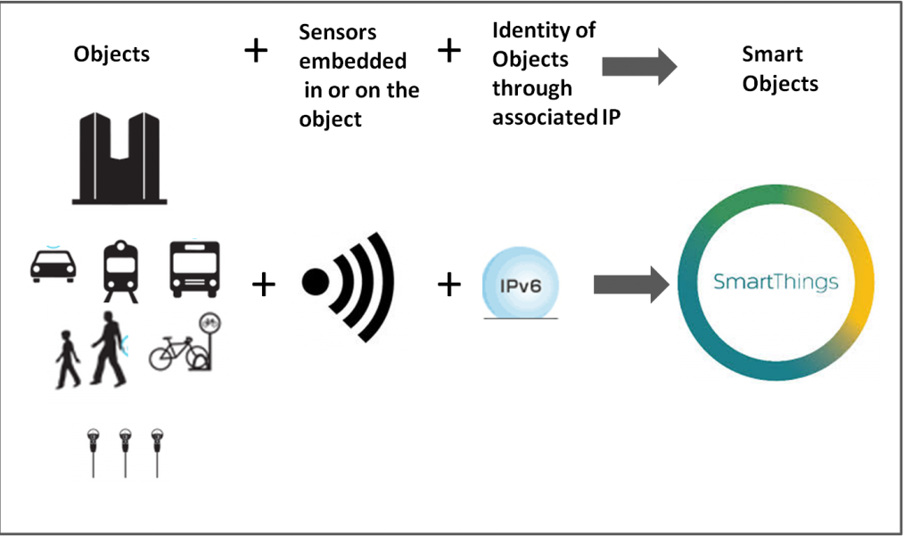
Smart Objects

Slide 33
References
https://iotboys.com/different-types-of-sensors/
https://www.thomasnet.com/articles/pumps-valves-accessories/types-of-actuators/
: “Sensor”, Hong Kong University of Science and Technology, online: https://ielm.ust.hk/dfaculty/ajay/courses/alp/ieem110/lec s/s ensors/sensors.html Source: “Repeatability”, MIT, Online: https://ocw.mit.edu/courses/mechanical engineering/2 693 principles of oceanographic instr ument systems sensors and measurements 13 998 spring 2004/

Slide 34
“Electric bell”, ЮК/ Wikimedia Commons/, Published date: 18 February 2008, Online: https://commons.wikimedia.org/wiki/File:Electric_Bell_animation.gif
“Electric motor”, Abnormaal/ Wikimedia Commons / CC-BY-SA-3.0 Unported/GFDL/, Published date: 21 May 2008, Online: https://commons.wikimedia.org/wiki/File:Electric_motor.gif
“Axial piston pump”, MichaelFrey/ Wikimedia Commons / CC-BY-SA-4.0 International/, Published date: 11 August 2017, Online: https://commons.wikimedia.org/wiki/File:Axialkolbenpumpe_-_einfache_Animation.gif
“Rigid chain actuator”, Catsquisher/ Wikimedia Commons/, Published date: 11 January 2011, Online: https://commons.wikimedia.org/wiki/File:Rigid_Chain_Actuator.gif

